Slide 1

Re-slotting Optimization Project
Jenny Salinas
Dushyant Vaishnaw
Alicia Loya
John Bergstrom
Jonah Wiley

Slide 2

Agenda
Define
Measure
Analyze
Improve
Control

Slide 3
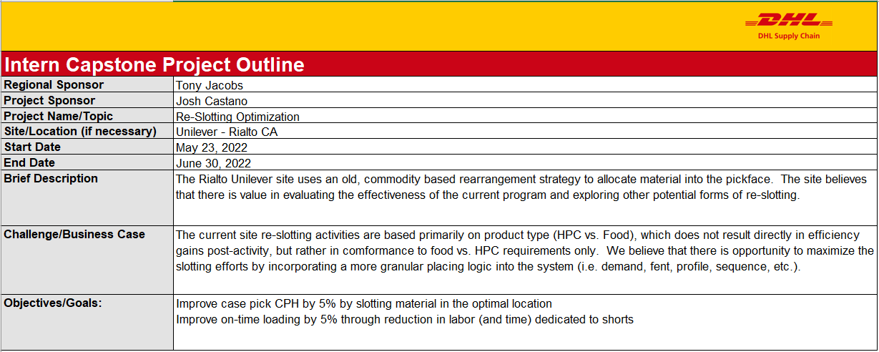
Define

Slide 4
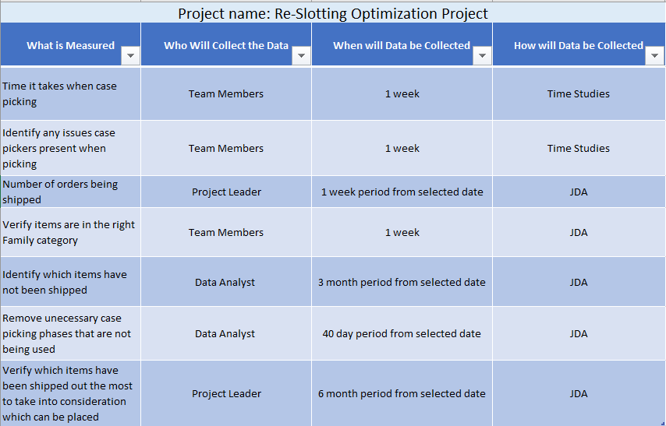
Measurement Plan

Slide 5
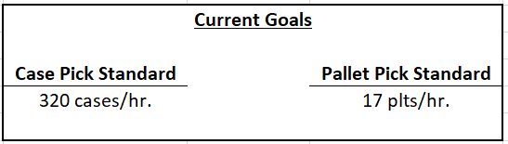
Current Goals

Slide 6
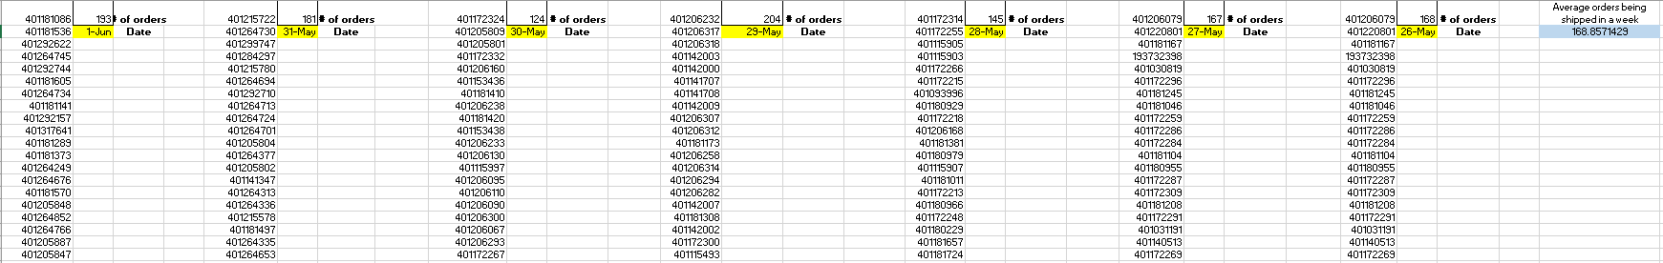
Orders shipped in a week

Slide 7
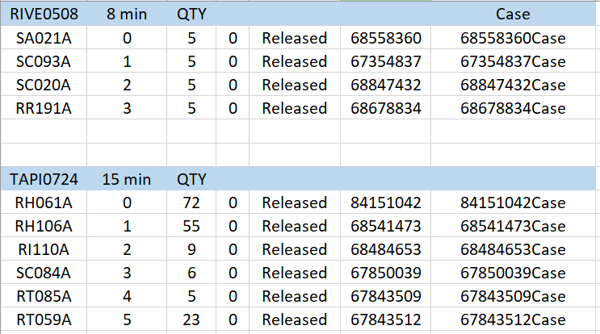
Case picking-Time studies (Before)

Slide 8
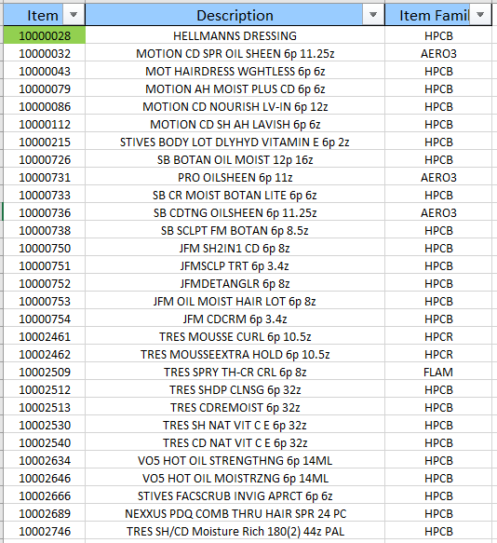
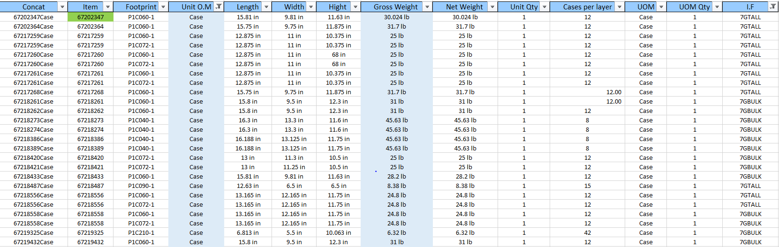
Items’ Description and Weight

Slide 9
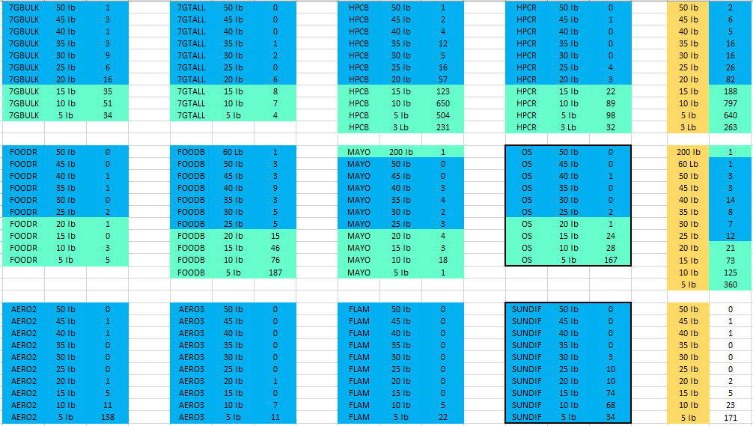

Overall Family Categories with Weight Range

Slide 10
Case Picking Racks
Number of racks available: 36

Slide 11
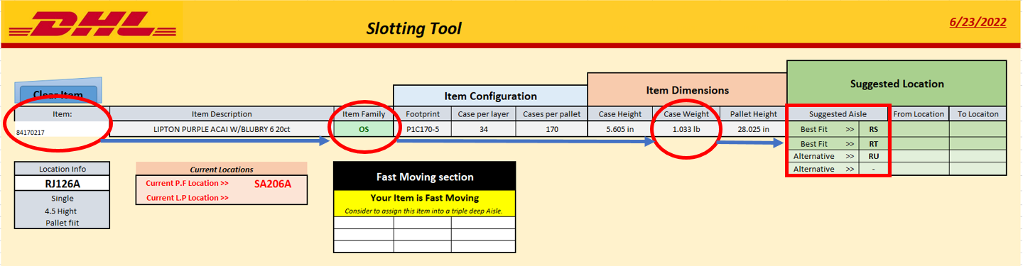
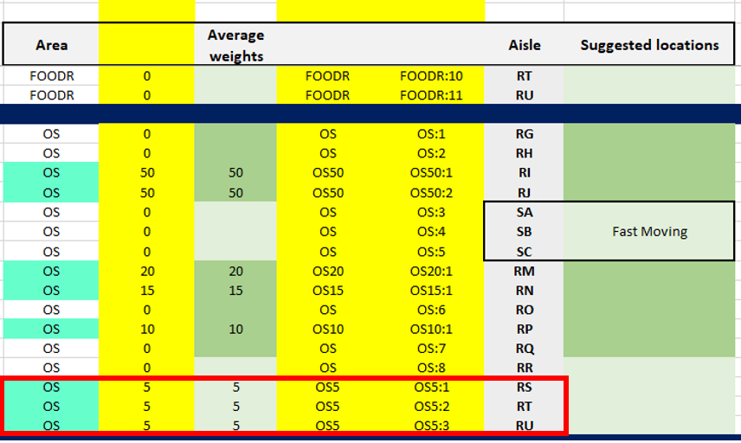
Slotting Tool

